Slide 1
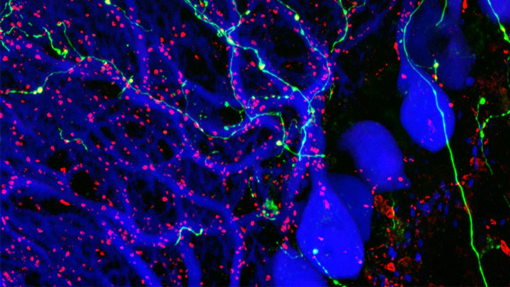
Classroom Slides: Brain Chemistry Teacher’s Guide
Nancy P. Moreno, PhD
Barbara Z. Tharp, MS
Tadzia GrandPré, PhD
Center for Educational Outreach
Baylor College of Medicine
© Mathieu Letellier. CC-BY-NC-ND.
Notes:
From Brain Chemistry Teacher’s Guide: “The Brain”
Did you ever wonder why you can respond so quickly when you are startled? Wonder why you can “see” a picture in your mind’s eye? Wonder why you can remember facts, events and skills that you learned or experienced a long time ago? Your brain and nervous system makes these and many more things possible by controlling virtually all functions of the body by transmitting neurotransmitters via specialized cells, called neurons.
Reference:
Brain Chemistry Teacher’s Guide © Baylor College of Medicine (ISBN: 978-1-888997-45-3) was supported, in part, by funds from the National Institutes of Health, Science Education Partnership Award grant number R25RR13454, and the NIH Blueprint for Neuroscience Research Science Education Award, National Institute on Drug Abuse and NIH Office of the Director, grant number 5R25DA033006.
Image reference:
Purkinje cells (immunofluorescence, blue), olivary axons (anterograde tracing, yellow-green) and synaptic terminals (immunofluorescence, red) are shown, revealing the highly specific organization of neuronal connections in a mouse cerebellum. Image by Mathieu Letellier, Honorable Mention, 2009 Olympus BioScapes Digital Imaging Competition®, http://www.cellimagelibrary.org/images/41920 CC-BY-NC-ND.

Slide 2
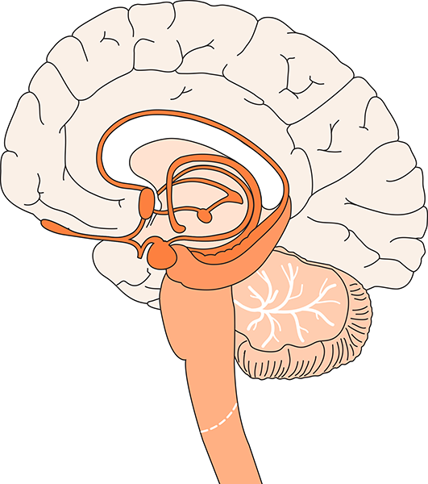
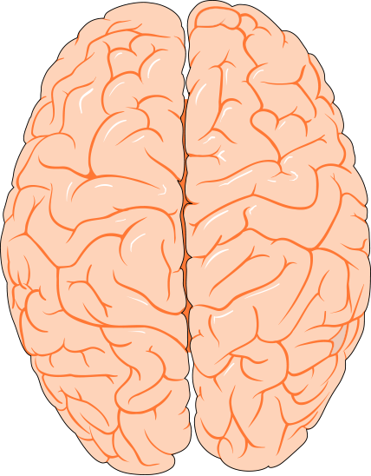
The Brain and Spinal Cord
Cerebrum
Cerebral Cortex
Corpus Callosum
Limbic System
Cerebral Hemispheres (top view)
Brain Stem
Cerebellum
Spinal Cord
Illustrations © Williams & Wilkins. All rights reserved.
Notes:
The brain of the average adult weighs about three pounds and fills over half the skull. Even though it is soft (like pudding), the brain can be divided into several regions, each with very specific functions.
The cerebrum, about 85% of the brain’s mass, sits above the brainstem and cerebellum. The surface of the cerebrum, known as the cerebral cortex, has bumps (gyri) and grooves (sulci). The cerebrum enables one to think, learn, reason, remember, feel sensations and emotions, and move muscles purposefully. It is comprised of two hemispheres (or halves), separated by a deep fissure.
The hemispheres are connected by a large bundle of nerve fibers known as the corpus callosum. They communicate with each other constantly. Even though the hemispheres may look the same, they are somewhat specialized for certain functions. For example, in most people, the ability to form words is a function that seems to be located within the left hemisphere, while the right hemisphere is better at processing spatial information. Different parts of each hemisphere handle specific functions, including hearing, vision, speech, memory, decision making and long-term planning.
The cerebellum sits at the back of the brainstem and is about the size of a tennis ball. It helps us maintain balance and posture, and coordinates our movements. The cerebellum also plays an important role in our ability to learn and remember new motor skills, such as riding a bike.
The limbic system is comprised of a number of interconnected brain regions, including areas within and under the cerebral hemispheres. It is involved in many emotions and motivations, especially those related to survival, such as anger, fear, and even the fight-or-flight response. The limbic system also plays an important role in feelings of pleasure, such as those experienced from eating and sex.
The brainstem connects directly with the spinal cord and is responsible for automatic functions of the body, including heartbeat, digestion, breathing, swallowing, coughing and sneezing. Automatic functions are present at birth and happen without thinking about them.
The brain’s main communication channel to the rest of the body is the spinal cord. Nerves branch out from the spinal cord and send and receive information.
Functions and abilities develop as the brain grows and matures. The human brain generally reaches close to 80% of its adult weight by the age of two or three, yet it continues to develop throughout adolescence and early adulthood. The region of the cerebral cortex responsible for judgment, organization and reasoning appears to be one of the last brain areas to reach maturity.
Reference:
From the Brain Chemistry Teacher’s Guide activity, “The Brain.” Brain Chemistry Teacher’s Guide © Baylor College of Medicine (ISBN: 978-1-888997-45-3) was supported, in part, by funds from the National Institutes of Health, Science Education Partnership Award grant number R25RR13454, and the NIH Blueprint for Neuroscience Research Science Education Award, National Institute on Drug Abuse and NIH Office of the Director, grant number 5R25DA033006.
Image reference:
Illustrations © Williams & Wilkins. All rights reserved.

Slide 3
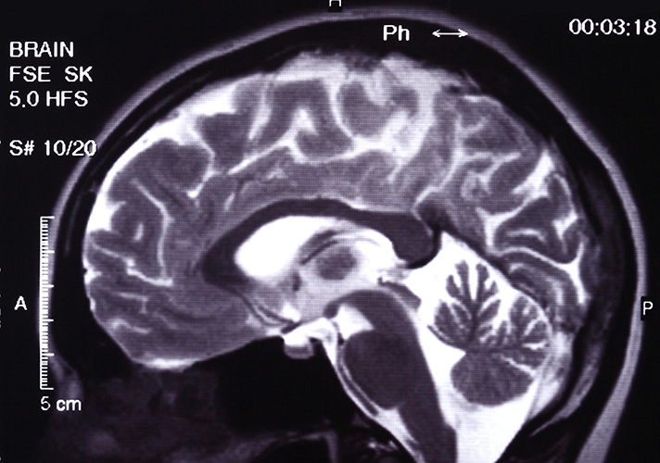
Internal Brain Structure
This MRI of a normal brain reveals the different regions of the brain, each of which has specific functions. Such detailed images allow physicians to visualize diseases, effects of injuries and abnormalities in the brain.
Image © Mikhail Basov.
Notes:
In this MRI of a normal brain, the cerebrum, cerebellum, brain stem, and other regions of the brain are clearly visible.
Reference:
From the Brain Chemistry Teacher’s Guide activity, “The Brain.” Brain Chemistry Teacher’s Guide © Baylor College of Medicine (ISBN: 978-1-888997-45-3) was supported, in part, by funds from the National Institutes of Health, Science Education Partnership Award grant number R25RR13454, and the NIH Blueprint for Neuroscience Research Science Education Award, National Institute on Drug Abuse and NIH Office of the Director, grant number 5R25DA033006.
Image reference:
MRI © Mikhail Basov.

Slide 4
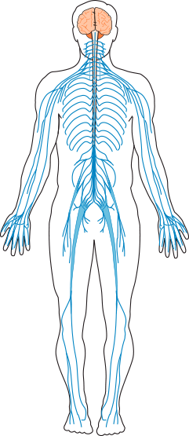
The Human Nervous System
The brain and spinal cord make up the central nervous system. All other nerves in the body form the peripheral nervous system.
Illustrations © Williams & Wilkins. All rights reserved.
Notes:
The brain is the command center of the central nervous system; it controls virtually all functions of the body. The brain’s main communication channel to the rest of the body is the spinal cord. Nerves branch out from the spinal cord and send and receive information. All other nerves in the body form the peripheral nervous system.
Reference:
From the Brain Chemistry Teacher’s Guide activity, “The Brain.” Brain Chemistry Teacher’s Guide © Baylor College of Medicine (ISBN: 978-1-888997-45-3) was supported, in part, by funds from the National Institutes of Health, Science Education Partnership Award grant number R25RR13454, and the NIH Blueprint for Neuroscience Research Science Education Award, National Institute on Drug Abuse and NIH Office of the Director, grant number 5R25DA033006.
Image reference:
Illustrations © Williams & Wilkins. All rights reserved.

Slide 5
Normal Brain Development
The MRI images above show normal brain development (left to right) at ages 1 week, 3 months, 1 year, 2 years, and 10 years. Images such as these serve as a baseline for pediatricians when determining problems within the brain.
MRI image courtesy of NIH from the MRI Study of Normal Brain Development Project.
Notes:
MRI images of brain development taken at ages 1 week, 3 months, 1 year, 2 years and 10 years.
Reference:
From the Brain Chemistry Teacher’s Guide activity, “The Brain.” Brain Chemistry Teacher’s Guide © Baylor College of Medicine (ISBN: 978-1-888997-45-3) was supported, in part, by funds from the National Institutes of Health, Science Education Partnership Award grant number R25RR13454, and the NIH Blueprint for Neuroscience Research Science Education Award, National Institute on Drug Abuse and NIH Office of the Director, grant number 5R25DA033006.
Image reference:
MRI courtesy of NIH from the MRI Study of Normal Brain Development project. http://pediatricmri.nih.gov/nihpd/info/index.html

Slide 6
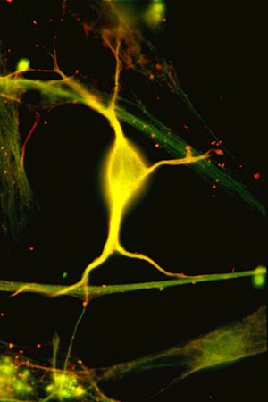
What Is a Neuron?
Microscopic image of a neuron from the hippocampus. Most neurons receive signals from many other neurons. The combined effects of these signals determine the response of the receiving neuron.
© Baylor College of Medicine\Robert S. McNeil.
Notes:
The human brain is the most complex structure in the known universe. Consisting of close to 100 billion nerve cells (and many times that number of supporting cells), the brain is the center of our thoughts and emotions. It receives and processes information from the world around us, directs our movements and controls automatic functions of our bodies. Amazingly, virtually all functions of the brain and the rest of the nervous system are based on communication among nerve cells, also known as neurons.
Reference:
From the Brain Chemistry Teacher’s Guide activity, “What Is a Neuron?” Brain Chemistry Teacher’s Guide © Baylor College of Medicine (ISBN: 978-1-888997-45-3) was supported, in part, by funds from the National Institutes of Health, Science Education Partnership Award grant number R25RR13454, and the NIH Blueprint for Neuroscience Research Science Education Award, National Institute on Drug Abuse and NIH Office of the Director, grant number 5R25DA033006.
Image reference:
Microscopic image © Baylor College of Medicine\Robert S. McNeil. http://www.neuralimages.org/

Slide 7
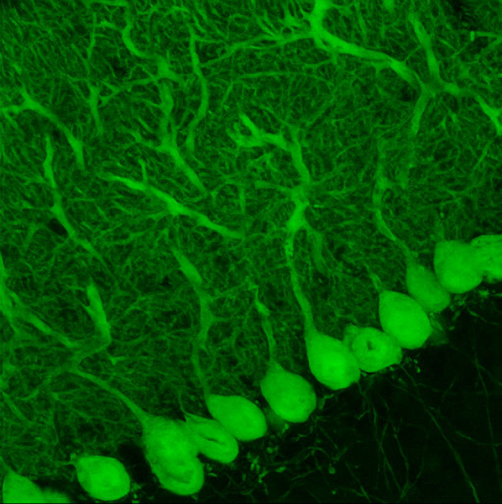
Purkinje Neurons
Purkinje cells are large neurons with branching, tree-like dendrites. These neurons form the sole output pathway of the cerebellar cortex, and they serve as an essential link in regulating the body’s muscle tone and movement.
SEM courtesy of The Gene Expression Nervous System Atlas (GENSAT) project, NINDS.
Notes:
Purkinje cells, or Purkinje neurons, are some of the largest neurons in the human brain, with an intricately elaborate dendritic arbor, characterized by a large number of dendritic spines. Purkinje cells constitute the sole output of all motor coordination in the cerebellar cortex.
Reference:
From the Brain Chemistry Teacher’s Guide activity, “What Is a Neuron?” Brain Chemistry Teacher’s Guide © Baylor College of Medicine (ISBN: 978-1-888997-45-3) was supported, in part, by funds from the National Institutes of Health, Science Education Partnership Award grant number R25RR13454, and the NIH Blueprint for Neuroscience Research Science Education Award, National Institute on Drug Abuse and NIH Office of the Director, grant number 5R25DA033006.
Image reference:
Scanning microscopic image courtesy of The Gene Expression Nervous System Atlas (GENSAT) Project, NINDS Contracts N01NS02331 & HHSN271200723701C to The Rockefeller University (New York, NY). http://www.gensat.org/index.html

Slide 8
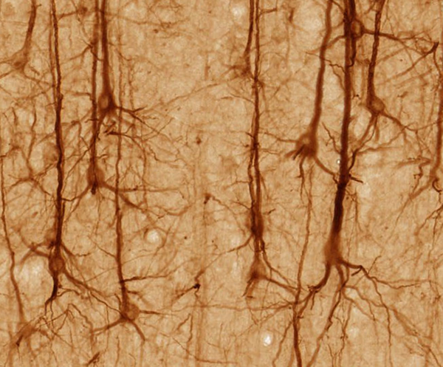
Pyramidal Neurons
Pyramidal cells are found in the cerebral cortex and other parts of the central nervous system. Pyramidal cells have a pyramid-shaped cell body and many dendritic branches.
BrainMaps: An Interactive Multiresolution Brain Atlas. CC-BY-SA 3.0.
Notes:
Pyramidal neurons (pyramidal cells) are a type of neuron found in areas of the brain including the cerebral cortex, the hippocampus, and the amygdala. The neuron's cell body is triangular in shape and consists of a single axon with three to five primary dendrites, and multiple branching dendrites and dendritic spines. Pyramidal cells are among the largest neurons in the brain, with cell bodies averaging at around 20 μm in length.
Reference:
From the Brain Chemistry Teacher’s Guide activity, “What Is a Neuron?” Brain Chemistry Teacher’s Guide © Baylor College of Medicine (ISBN: 978-1-888997-45-3) was supported, in part, by funds from the National Institutes of Health, Science Education Partnership Award grant number R25RR13454, and the NIH Blueprint for Neuroscience Research Science Education Award, National Institute on Drug Abuse and NIH Office of the Director, grant number 5R25DA033006.
Image reference:
BrainMaps: An Interactive Multiresolution Brain Atlas; http://brainmaps.org. (https://commons.wikimedia.org/wiki/File:Smi32neuron.jpg CC-BY-SA 3.0. )

Slide 9
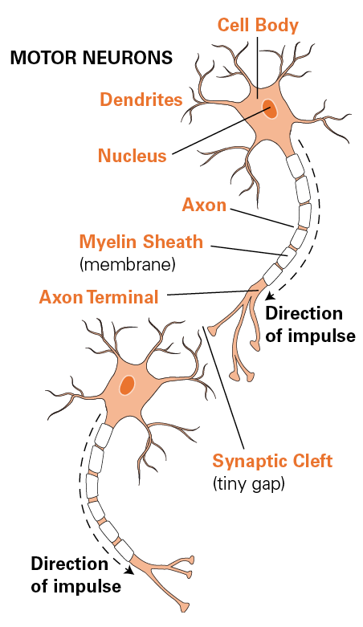
Typical Structure of Neurons
A typical neuron has an enlarged cell body which contains the nucleus. Most neurons have branches, known as dendrites. Each neuron typically also has a longer tail-like fiber, or extension, called an axon.
Information typically is received on the dendrites or cell body, and is transmitted in one directions down the axon and passed to next neuron.
Neurons vary greatly in size and shape. Although neurons generally have only a single axon, they can have hundreds of dendrites.
Illustration © Williams & Wilkins. All rights reserved.
Notes:
A typical neuron has an enlarged area, the cell body, which contains the nucleus. Neurons typically also have two types of specialized extensions that project away from the cell body. The branches on which information is received are known as dendrites. Each neuron usually has many dendrites. Each neuron usually also has a longer tail-like structure, or axon, which transmits information to other cells.
Axons can be branched at their tips. The axons of many kinds of neurons are surrounded by a fatty, segmented covering called the myelin sheath. This covering acts as a kind of insulation and improves the ability of axons to carry nervous system signals rapidly. In humans, axons can vary from only a fraction of an inch to more than 3 feet in length! The longest axons extend from the base of the spine all the way to the big toe of each foot.
Neurons communicate with one another through special junctions known as synapses. With the most common type of synapse, known as a chemical synapse, neurons do not actually touch. Rather, the end of the axon (or axon terminal) of one neuron is separated from the next neuron by a tiny gap called a synaptic cleft. Messages traveling from one neuron to the next must cross this gap and bind to the next neuron for the signal to continue along its path. Typically, a single neuron may be capable of receiving messages simultaneously on its dendrites and cell body from several thousand different neurons.
Reference:
From the Brain Chemistry Teacher’s Guide activity, “Neural Network Signals.” Brain Chemistry Teacher’s Guide © Baylor College of Medicine (ISBN: 978-1-888997-45-3) was supported, in part, by funds from the National Institutes of Health, Science Education Partnership Award grant number R25RR13454, and the NIH Blueprint for Neuroscience Research Science Education Award, National Institute on Drug Abuse and NIH Office of the Director, grant number 5R25DA033006.
Image reference:
Illustration © Williams & Wilkins. All rights reserved.

Slide 10
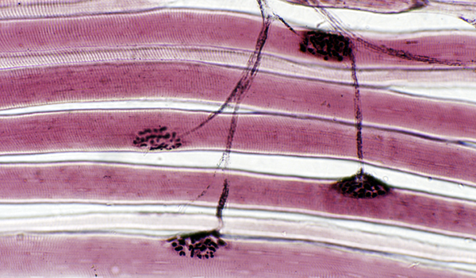
Neuron Firing
This microscopic image shows a motor neuron’s nerve endings on top of muscle fibers. When a neuron fires, a neurotransmitter is released into the space between the motor neuron (synaptic cleft) and that of the muscle fiber; it diffuses across the space and triggers the series of events that leads to contraction of the muscle.
Image courtesy of Thomas Caceci, PhD, Virginia-Maryland Regional College of Veterinary Medicine.
Notes:
The photo is of a motor neuron’s nerve endings on top of skeletal muscle fibers. The dark, bumpy areas at the end of each nerve are called motor end plates (neuromuscular junctions). Each motor end plate is associated with only one muscle fiber. When the neuron fires, acetylcholine (a neurotransmitter) is released into the space between the motor neuron (synaptic cleft) and that of the muscle fiber; it diffuses across the space and triggers the series of events that leads to contraction of the muscle.
Reference:
From the Brain Chemistry Teacher’s Guide activity, “Neural Network Signals.” Brain Chemistry Teacher’s Guide © Baylor College of Medicine (ISBN: 978-1-888997-45-3) was supported, in part, by funds from the National Institutes of Health, Science Education Partnership Award grant number R25RR13454, and the NIH Blueprint for Neuroscience Research Science Education Award, National Institute on Drug Abuse and NIH Office of the Director, grant number 5R25DA033006.
Image reference:
Miscroscopic image courtesy of Thomas Caceci, PhD, Virginia-Maryland Regional College of Veterinary Medicine. http://www.vetmed.vt.edu/education/curriculum/vm8054/Labs/Lab10/lab10.htm

Slide 11
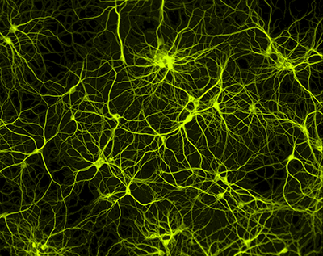
Neuron Circuits
When a neuron “fires,” it sends an impulse to one or more other neurons.
Some neurons are coupled directly, so that an electrical signal traveling down one neuron passes directly to the next one.
Other neurons use chemical messengers, known as neurotransmitters, to send signals to other neurons.
SEM courtesy of Paul De Koninck, PhD, Laval University.
Notes:
Chemical changes along the length of a neuron's cell membrane cause an electrical charge to move in one direction along the length of the cell's axon. Once the signal reaches the end of the axon, it is passed to the next nerve cell either electrically or by a chemical messenger that crosses the synaptic cleft between nerve cells.
Once the signal reaches the end of the axon (or axon terminal) of a neuron, it must move through the synaptic cleft to the next neuron. At the most common type of synapse, known as a chemical synapse, the impulse triggers the release of chemical messengers, called neurotransmitters, from special pockets known as vesicles.
Reference:
From the Brain Chemistry Teacher’s Guide activity, “Neural Network Signals.” Brain Chemistry Teacher’s Guide © Baylor College of Medicine (ISBN: 978-1-888997-45-3) was supported, in part, by funds from the National Institutes of Health, Science Education Partnership Award grant number R25RR13454, and the NIH Blueprint for Neuroscience Research Science Education Award, National Institute on Drug Abuse and NIH Office of the Director, grant number 5R25DA033006.
Image reference:
Scanning electroni microscope image of a neural network. SEM courtesy of Paul De Koninck, PhD, Laval University. http://www.greenspine.ca/

Slide 12
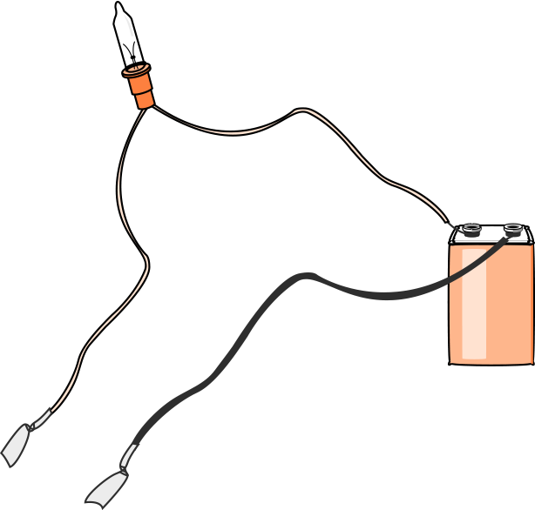
Build a Circuit
Wrap the exposed end of one wire from the light bulb around one pole on the battery. Tape it in place with a piece of electrical tape.
Attach the end of the other wire to the second battery pole and tape it in place.
Test the connection by briefly touching the exposed ends of the two loose wires together. (The bulb should burn brightly.)
Wrap the exposed ends of the loose wires with the aluminum foil, as shown above.
Notes:
Student Activity: Sending the Signals
Part 1:
Wrap the exposed end of one wire from the light bulb around one pole on the battery. Tape it in place with a piece of electrical tape.
Attach the end of the other wire to the second battery pole and tape it in place.
Test the connection by briefly touching the exposed ends of the two loose wires together. (The bulb should burn brightly.)
Wrap the exposed ends of the loose wires with the aluminum foil, as shown above.
Part 2:
All cells contain water, some dissolved salts and sugar. Which substances in cells help conduct electricity?
You will investigate what happens when a tiny amount of electricity passes through distilled water, a saltwater solution, and a sugar-water solution.
1. You have three labeled cups of distilled water, a container of salt and a container of sugar. Pour the salt into the cup of water labeled “salt,” and stir until the salt dissolves. Pour the sugar into the cup of water labeled “sugar,” and stir until the sugar dissolves.
2. On a separate sheet of paper, or on the back of this sheet, create a chart (see sample chart, PDF) to record your predictions, reasons for your predictions, and test results for each liquid tested.
3. What do you think will happen when you put the foil-wrapped wires in the different solutions? Record your predictions and reasons.
4. Test the first solution by inserting both foil-wrapped tips below the surface of the liquid. Keep the tips apart. Record the results. Next, test each of the other two liquids and record the results.
5. Based on your observations, which substances in cells would you say helped conduct electricity? Write a paragraph describing the steps you followed, your observations and your answers to this question.
Reference:
From the Brain Chemistry Teacher’s Guide activity, “Neural Network Signals.” Brain Chemistry Teacher’s Guide © Baylor College of Medicine (ISBN: 978-1-888997-45-3) was supported, in part, by funds from the National Institutes of Health, Science Education Partnership Award grant number R25RR13454, and the NIH Blueprint for Neuroscience Research Science Education Award, National Institute on Drug Abuse and NIH Office of the Director, grant number 5R25DA033006.
Image reference:
Illustration by Martha S. Young © Baylor College of Medicine. http://www.bcm.edu/

Slide 13
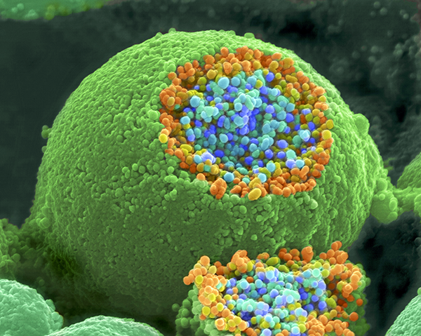
Neurotransmitters Contain Chemicals
A scanning electron microscope image of a nerve ending (large, round object). It has been broken open to reveal vesicles containing chemicals (orange and blue) used to pass messages in the nervous system.
Image courtesy of Tina Carvalho, MS, University of Hawai’i.
Notes:
Neurotransmitters (chemical messengers) released from the vesicles of one neuron leave the cell and physically move through a narrow watery space between neurons, called the synaptic gap. This space between the two neurons is about 20 nanometers (one nanometer equals 0.000,000,1 centimeters).
The joining of the neurotransmitters to their specific receptor sites on the receiving neuron can promote the generation of a new electrical impulse (the neuron “fires”) OR the neurotransmitters can have an inhibitory effect, making it harder for the neuron to fire.
Reference:
From the Brain Chemistry Teacher’s Guide activity, “Neurotransmitters Contain Chemicals.” Brain Chemistry Teacher’s Guide © Baylor College of Medicine (ISBN: 978-1-888997-45-3) was supported, in part, by funds from the National Institutes of Health, Science Education Partnership Award grant number R25RR13454, and the NIH Blueprint for Neuroscience Research Science Education Award, National Institute on Drug Abuse and NIH Office of the Director, grant number 5R25DA033006.
Image reference:
SEM image of a nerve ending with its neurotransmitters. SEM courtesy of Tina Carvalho, MS, University of Hawai’i (released to public domain). http://www.cellimagelibrary.org/images/214

Slide 14
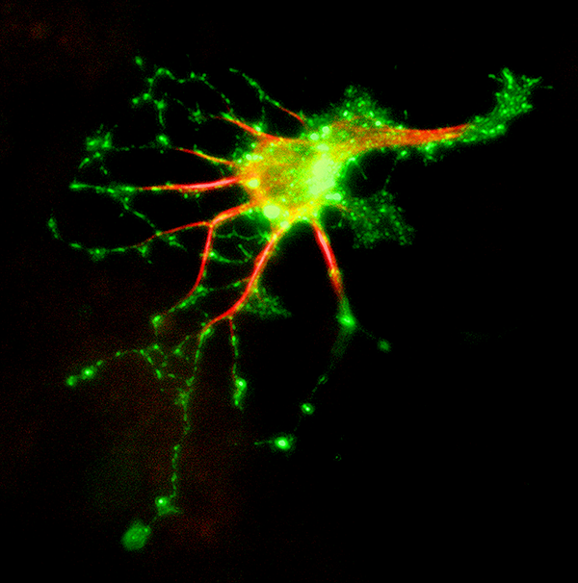
Neurons Have Specialized Receptors
Microscopic image of a single neuron stained to reveal receptor sites for a specific chemical.
Image © Baylor College of Medicine\Robert S. McNeil.
Notes:
Biologists have identified more than 100 different neurotransmitters. Each has a different three-dimensional shape, which fits only a certain kind of receptor site. The relationship between a neurotransmitter and its receptor is similar to that of a key and a lock.
Reference:
From the Brain Chemistry Teacher’s Guide activity, “Neurotransmitters Contain Chemicals.” Brain Chemistry Teacher’s Guide © Baylor College of Medicine (ISBN: 978-1-888997-45-3) was supported, in part, by funds from the National Institutes of Health, Science Education Partnership Award grant number R25RR13454, and the NIH Blueprint for Neuroscience Research Science Education Award, National Institute on Drug Abuse and NIH Office of the Director, grant number 5R25DA033006.
Image reference:
Microscopic image of a hippocampal neuron © Baylor College of Medicine\Robert S. McNeil. http://www.neuralimages.org/

Slide 15
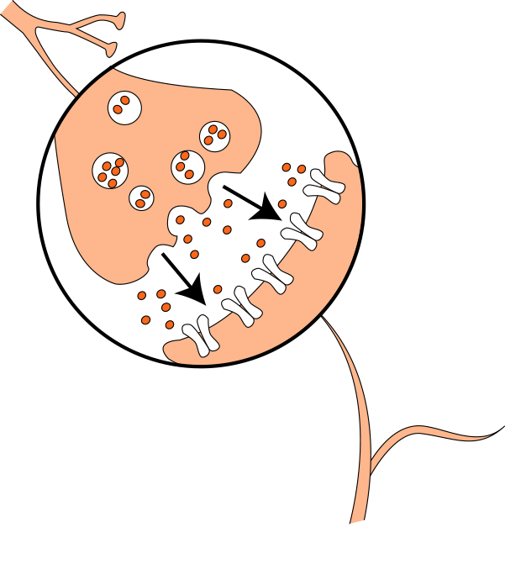
Chemical Communication
In most cases, communication across the synapse occurs chemically instead of electrically. Chemical messengers, called neurotransmitters, can either promote or inhibit the firing of receiving neurons.
Illustration © Baylor College of Medicine\M.S. Young.
Notes:
Each of the billions of neurons in the nervous system communicate with one another and with other cells, such as muscle cells, through special junctions known as synapses. Some neurons share synapses with thousands of other cells. Others connect with only a few cells.
In some cases, instead of binding to the receiving neuron, neurotransmitters simply float (diffuse) away from the synapse. Other neurotransmitters are broken down or degraded by enzymes found within the synaptic cleft. Many neurotransmitters are transported, whole, back into the neuron that released them. Some drugs, such as cocaine and fluoxetine (Prozac®), exert their effects by interfering with the removal of neurotransmitters from the synapse.
Sometimes, neurons do not communicate through neurotransmitters. Instead, an electrical charge passes directly from neuron to neuron through what is known as an electrical synapse. This type of signaling, in which the communicating neurons are very close together, is very fast and allows many interconnected neurons to fire at the same time. Electrical synapses are less common than chemical synapses, but they are very important for the normal development and function of the nervous system.
Reference:
From the Brain Chemistry Teacher’s Guide activity, “Neurotransmitters Contain Chemicals.” Brain Chemistry Teacher’s Guide © Baylor College of Medicine (ISBN: 978-1-888997-45-3) was supported, in part, by funds from the National Institutes of Health, Science Education Partnership Award grant number R25RR13454, and the NIH Blueprint for Neuroscience Research Science Education Award, National Institute on Drug Abuse and NIH Office of the Director, grant number 5R25DA033006.
Image reference:
Illustration © Baylor College of Medicine\M.S. Young. http://www.bcm.edu/

Slide 16
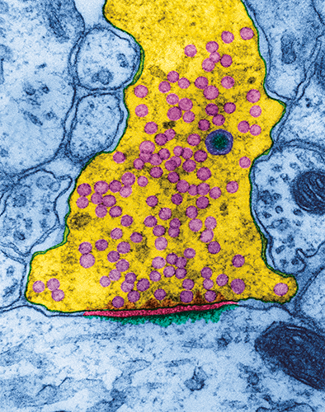
Crossing the Synaptic Gap
This microscopic image has been modified to reveal the synaptic cleft between the axon of a nerve cell in the hippocampus (part of the limbic system needed for memory) and a receiving neuron. Vesicles (small, circular pink objects) release neurotransmitters into the synaptic cleft.
Transmitting Neuron
Synaptic Gap
Receiving Neuron
TEM image © Dennis Kunkel Microscopy, Inc.
Notes:
Most neurons in the brain communicate with each other by releasing chemical messengers called neurotransmitters. Neurotransmitters cross the gaps between neurons or between neurons and other cells, such as muscle, and match up with specific receptors. Chemical signaling between neurons allows different kinds of messages to be sent. For example, some chemical messengers stimulate neurons to fire, while other messengers make it harder for an electrical impulse to be generated in the receiving neuron. Since one neuron can share synapses with thousands of other neurons, the combined effects of different messages ultimately determine whether a signal will be triggered or not.
Many drugs interfere with communication between nerve cells. Some drugs act directly on neurons, neurotransmitters and receptors. Curare, for example, is a deadly poison used by South American Indians. It causes death from paralysis by blocking receptors on muscle cells. Since the receptors are blocked, the real chemical messenger for muscle contraction (acetylcholine) can no longer stimulate the muscles to contract.
Drugs also can interfere with communication between neurons in other ways, such as by preventing the manufacture or release of neurotransmitters, by causing excessive firing of neurons by stimulating massive releases of neurotransmitters, by mimicking the effects of chemical messengers, or by preventing the normal breakdown and recycling of chemical messengers.
Reference:
From the Brain Chemistry Teacher’s Guide activity, “Crossing the Synaptic Gap.” Brain Chemistry Teacher’s Guide © Baylor College of Medicine (ISBN: 978-1-888997-45-3) was supported, in part, by funds from the National Institutes of Health, Science Education Partnership Award grant number R25RR13454, and the NIH Blueprint for Neuroscience Research Science Education Award, National Institute on Drug Abuse and NIH Office of the Director, grant number 5R25DA033006.
Image reference:
Transmission electron microscopic image of the synaptic gap between two neurons. TEM image © Dennis Kunkel Microscopy, Inc. http://education.denniskunkel.com/catalog/home.php

Slide 17
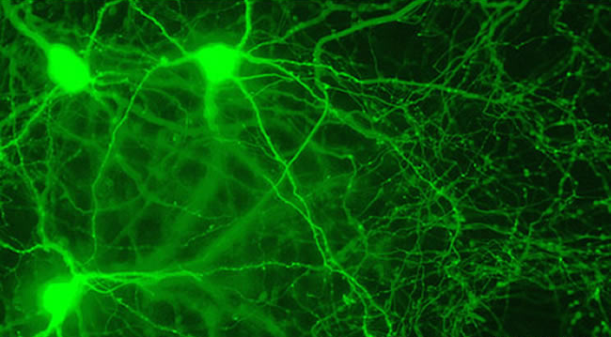
A Balance of Hormones
Special neurons in the hypothalamus region, like the three shown above, release hormones associated with high calorie intake and lower energy levels. Other neurons in the hypothalamus release hormones that act in direct opposition, thereby providing clues as to how the brain controls our food intake and sleep patterns.
SEM courtesy of Anthony van den Pol, PhD, Yale School of Medicine.
Notes:
Our bodies’ reactions to stress are controlled by the brain. Immediate stress responses are directed through pathways in the brainstem and spinal cord to the major internal organs of the body. However, chemicals circulating in the bloodstream also help prepare the body to handle a crisis. The brain coordinates the release of these chemicals, which belong to the family of messengers known as hormones.
Unlike the chemical messengers between neurons (neurotransmitters), hormones can have wide-reaching effects on many different body tissues at the same time. Hormones, which circulate in the bloodstream, act as messengers to the nervous system and other tissues in the body. They act only on cells that have compatible receptors.
Hormones have many vital functions in mammals, such as regulating digestion; controlling the metabolism of sugars, proteins and fats; and regulating growth and development. Many of our most basic drives—sleeping, hunger, thirst, sex—are regulated through hormones.
The master control system for all hormones is located within the brainstem. Known as the hypothalamus, this small structure interconnects with many regions of the brain. It is adjacent to the pituitary gland, which produces hormones that control other glands in the body. Together, the hypothalamus and the pituitary gland regulate many different body functions.
During periods of stress, these tiny structures direct the two small adrenal glands near the kidneys to produce hormones, such as adrenaline (also called epinephrine), that prepare the body for action.
Reference:
From the Brain Chemistry Teacher’s Guide activity, “Hormones and Stress.” Brain Chemistry Teacher’s Guide © Baylor College of Medicine (ISBN: 978-1-888997-45-3) was supported, in part, by funds from the National Institutes of Health, Science Education Partnership Award grant number R25RR13454, and the NIH Blueprint for Neuroscience Research Science Education Award, National Institute on Drug Abuse and NIH Office of the Director, grant number 5R25DA033006.
Image reference:
Scanning electron microscope image of neurons courtesy of Anthony van den Pol, PhD © Yale School of Medicine. http://medicine.yale.edu/news/article.aspx?id=979

Slide 18
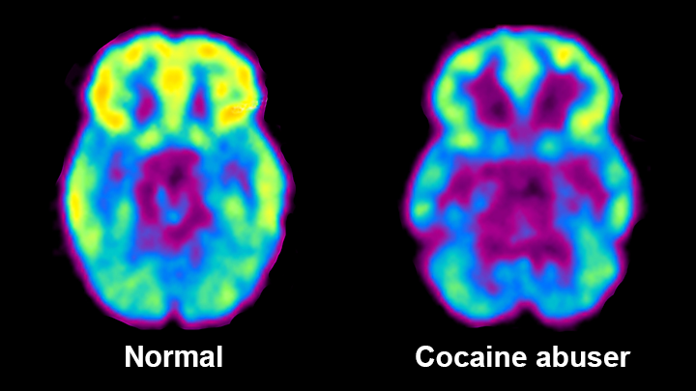
Seeing Addiction in the Brain
Drug addiction compromises the brain circuits involved in processing reward and punishment, and in exerting control over one’s actions.
This set of MRI scans shows what happens in the brain when drugs are abused.
On the left is a scan of a normal brain. Notice the bright areas of activity. The scan on the right is of a person who is abusing cocaine. The large dark areas show the loss of neuronal activity. This loss can be reversed if an abuser stops taking the drug.
MRI image courtesy of NIDA.
Notes:
It is important to note that most people begin to use brain-altering chemicals voluntarily. Over time, however, the brain and body may adapt to the effects of a chemical. This can create a new “normal” state, adjusted to the presence of the introduced substance. This adaptation may lead to a physical dependence on the substance, such that the individual requires the chemical to function normally.
For example, more than 80 percent of the current US population chooses to consume the stimulant caffeine in coffee and/or cola drinks because of its taste and/or perceived enhancement of mental and physical performance. Eventually, most caffeine consumers develop a dependence on its stimulating effects and experience mild withdrawal symptoms, such as sleepiness and headaches, when they do not have caffeine.
Other chemicals have more dramatic effects on the brain and body, affecting the brain’s natural reward centers, which are responsible for generating feelings of pleasure or well-being. However, feelings of euphoria, comfort or pleasure often decrease or disappear after the first few uses of the substance.
Drugs that act on areas of the brain related to sensations of pleasure are sometimes used inappropriately by people. Unfortunately, continued drug use actually changes the way the brain works. In some cases, it can cause permanent changes in the structure and function of the brain. This is the biological basis of addiction.
Many mind-altering chemicals abused by children and adults in the US lead to permanent changes in the brain that lead to addiction, and also may cause damage to other parts of the body.
Marijuana use can alter memory regions of the brain and affect coordination and the senses in the short term.
Heroin changes the way nerve cells in the brain receive and process messages.
Inhalants, which are taken up by fatty tissue in the body, damage or destroy the fat-containing myelin sheath on nerve cell axons and disrupt nervous system communications, sometimes permanently.
LSD can contribute to the development of chronic mental disorders.
Alcohol, which depresses physical and mental abilities, damages many tissues throughout the body, including the liver and the brain. Alcohol also is a major contributing factor to automobile accidents because it affects coordination and judgment.
Nicotine, a stimulant in tobacco, is a very addictive substance that can damage the circulatory system. However, the greatest health risk from smoking comes from other compounds in cigarette and cigar smoke that are linked to development of lung and other cancers. Nicotine is one of the most addictive substances in common use.
Reference:
From the Brain Chemistry Teacher’s Guide activity, “Drugs, Risks and the Nervous System.” Brain Chemistry Teacher’s Guide © Baylor College of Medicine (ISBN: 978-1-888997-45-3) was supported, in part, by funds from the National Institutes of Health, Science Education Partnership Award grant number R25RR13454, and the NIH Blueprint for Neuroscience Research Science Education Award, National Institute on Drug Abuse and NIH Office of the Director, grant number 5R25DA033006.
Image reference:
MRI image courtesy of NIDA. http://www.drugabuse.gov/publications/science-addiction/drug-abuse-addiction

Slide 19
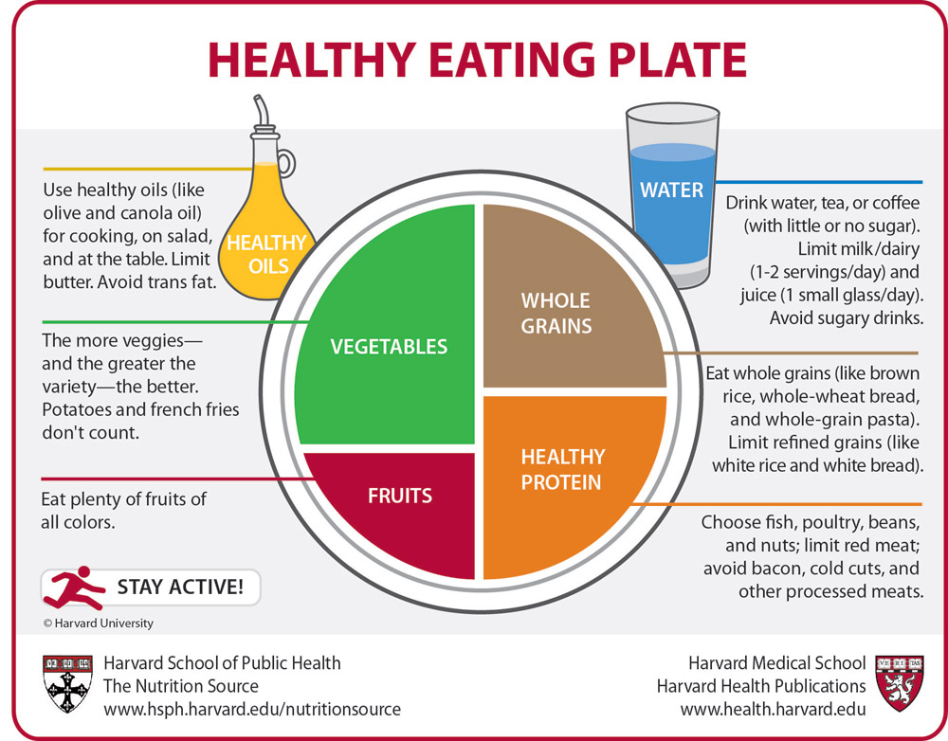
Food for the Brain
Notes:
Student Activity: Healthy Plates
1. List all the foods you have eaten in the past 24 hours, by meal (including snacks), on a separate sheet of paper.
2. Compare the foods in each meal to the recommendations in the Healthy Eating Plate. Keep in mind that many foods combine items from two or more groups.
3. On separate sheet of paper, make a chart with each food group shown in the diagram. List the foods you ate under the appropriate food groups.
4. Write an explanation of how closely the amounts and kinds of food you ate matched the recommendations in the Healthy Eating Plate.
Extensions
Encourage students to create or find recipes that include many nutrients needed by the brain. Share these with the class OR have a “Brain Food Day,” during which students (or parents) bring different foods to share in class, or prepare one or more of the students’ recipes in class.
Have students use an online Calorie counter or App to investigate the caloric, fat and nutrient content of common fast foods.
Reference:
From the Brain Chemistry Teacher’s Guide activity, “Food for the Brain.” Brain Chemistry Teacher’s Guide © Baylor College of Medicine (ISBN: 978-1-888997-45-3) was supported, in part, by funds from the National Institutes of Health, Science Education Partnership Award grant number R25RR13454, and the NIH Blueprint for Neuroscience Research Science Education Award, National Institute on Drug Abuse and NIH Office of the Director, grant number 5R25DA033006.
Image reference:
Health Eating Plate © 2011, Harvard University. For more information about The Healthy Eating Plate, please see The Nutrition Source, Department of Nutrition, Harvard School of Public Health. http://www.health.harvard.edu/plate/healthy-eating-plate

Slide 20
Reading Food Labels
Serving sizes often are smaller than the portions we actually eat.
Look for low levels of saturated, hydrogenated and trans fats.
Cholesterol is found in foods of animal origin.
Look for foods that have more carbohydrates as fiber and fewer as sugar. Only foods from plants provide fiber.
Protein is important for muscles and growth. It is found in animal and plant foods.
Vitamins and minerals are essential for health. Calcium is important for bones and teeth.
The amount of calories needed by each person depends on many factors, including exercise.
Notes:
The brain needs many different kinds of nutrients. Glucose, a kind of sugar, is the main source of energy for the brain. While all carbohydrates can serve as sources of glucose, some are better than others. Breads, pastas, cereals and other foods made with whole grains provide the brain with steady supplies of glucose. Foods that contain white sugar or corn syrup, white rice, white flour (found in white bread and most cakes, crackers and cookies) and other refined carbohydrates also supply energy. However, they cause glucose levels in the bloodstream to rise rapidly and then crash.
Proteins from food provide the amino acids used to make neurotransmitter molecules. Meat, fish, poultry, dairy products, eggs and beans (including soy beans) are good sources of proteins. The cell membranes of neurons are made of fats. The healthiest fats are liquid at room temperature. Olive, flaxseed and canola oils are examples of healthy fats. In addition, oils from coldwater fish, such as mackerel, salmon and trout are good sources of a kind of fat needed to build cell membranes in the brain.
Minerals such as calcium, sodium and potassium are vital for the generation and conduction of electrical impulses in neurons and are involved in the release of neurotransmitters from axon terminals. Vitamins are essential molecules needed in small amounts by cells throughout the body, including neurons. For example, choline, a vitamin found in egg yolks and leafy green vegetables, is the basis for the chemical messenger, acetylcholine, that transmits signals to muscles.
The diets of many adolescents are high in sugars and unhealthy fats. In addition, the “supersized portions” of snack and fast foods eaten by many students supply too many calories. Calories measure the amount of energy provided by food. They can be obtained from the breakdown of many different kinds of molecules, particularly fats, carbohydrates and proteins. The body needs a certain amount of calories each day as fuel.
Excess calories are stored as body fat. Unfortunately, even though many American children consume several times the amount of calories they actually need, they are not supplying their bodies with nutrients needed for optimum growth and development.
Reference:
From the Brain Chemistry Teacher’s Guide activity, “Food for the Brain.” Brain Chemistry Teacher’s Guide © Baylor College of Medicine (ISBN: 978-1-888997-45-3) was supported, in part, by funds from the National Institutes of Health, Science Education Partnership Award grant number R25RR13454, and the NIH Blueprint for Neuroscience Research Science Education Award, National Institute on Drug Abuse and NIH Office of the Director, grant number 5R25DA033006.
Image reference:
Illustration © Baylor College of Medicine\M.S. Young.

